Slide 1


Wattmeter
bot
Di Gaetano Eugenio

Slide 2

Bots: introduction
Bots are third-party applications that run inside Telegram.
Users can interact with bots by sending them messages, commands and inline requests.
Di Gaetano Eugenio

Slide 3
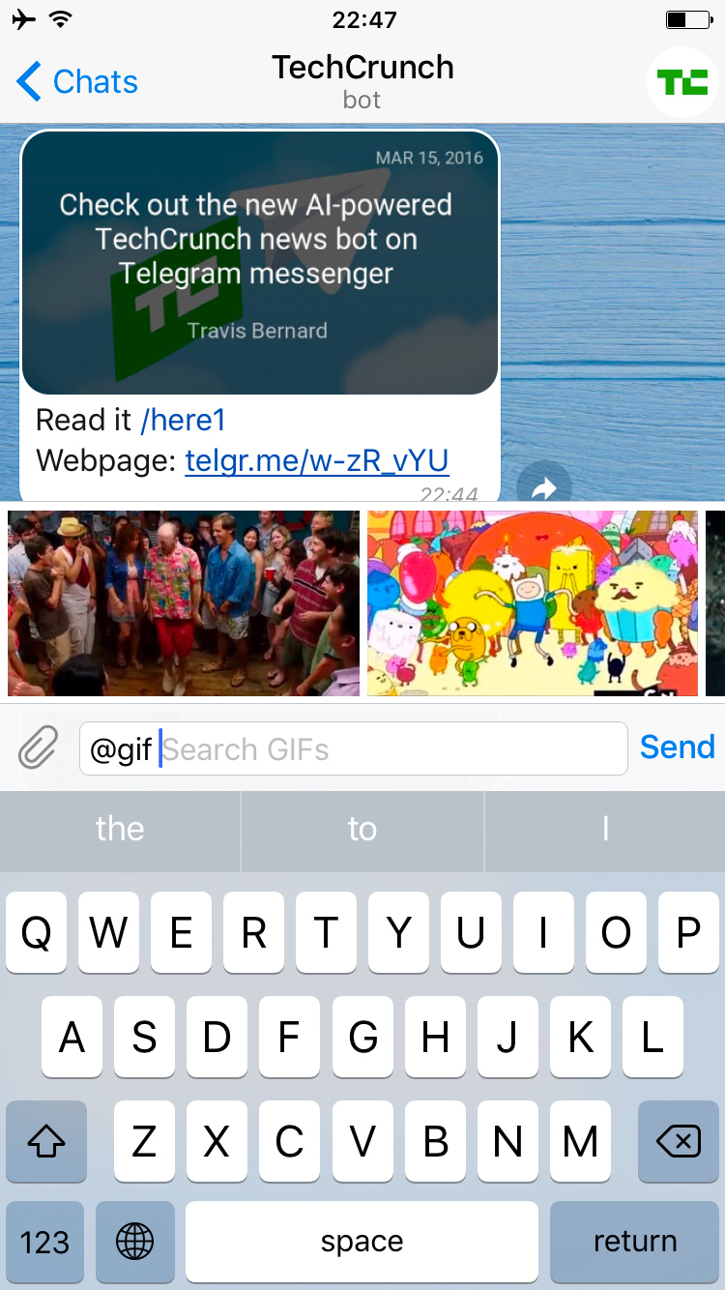
What can I do with bots?
You could use bots to:
Get customized notifications and news.
Integrate with other services.
Accept payments from Telegram users
Create custom tools.
Build single- and multiplayer games.
Build social services.
Do virtually anything else.
Di Gaetano Eugenio

Slide 4
How do bots work?
At the core, Telegram Bots are special accounts that do not require an additional phone number to set up. Users can interact with bots in two ways:
Send messages and commands to bots by opening a chat with them or by adding them to groups.
Send requests directly from the input field by typing the bot's @username and a query.
Messages, commands and requests sent by users are passed to telegram intermediary server that handles all encryption and communication with the Telegram API.
Di Gaetano Eugenio

Slide 5
How are bots different from humans?
Bots have no online status and no last seen timestamps, the interface shows the label 'bot' instead.
Bots have limited cloud storage — older messages may be removed by the server shortly after they have been processed.
Bots can't initiate conversations with users.
Bot usernames always end in 'bot' (@TriviaBot, @GitHub_bot).
When added to a group, bots do not receive all messages by default (see Privacy mode).
Bots never eat, sleep or complain (unless expressly programmed otherwise).
Di Gaetano Eugenio

Slide 6

How do I create a bot?
There's a… bot for that (@BotFather).
Once you've created a bot and received your unique authentication token.
Di Gaetano Eugenio

Slide 7
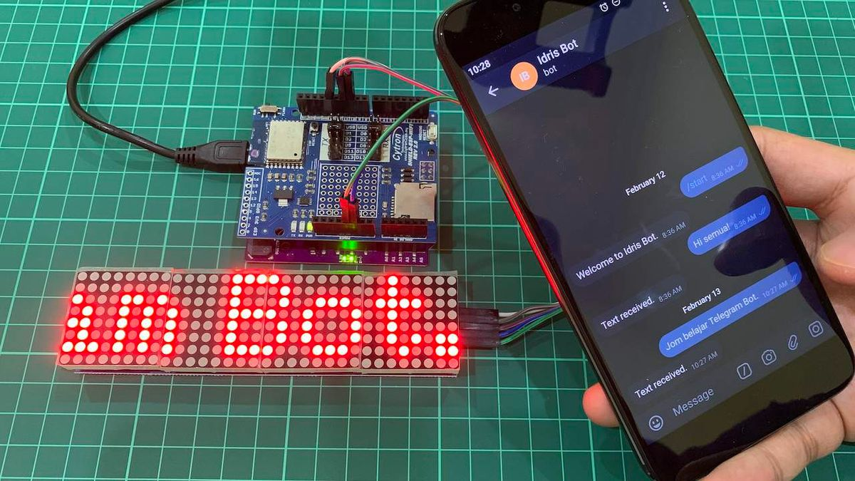
How to build telegram bot?
The Bot API is an HTTP-based interface created for developers keen on building bots for Telegram.
To build a telegram bot we use the Universal-Arduino-Telegram-Bot,
An Arduino IDE library for using Telegram Bot API. It's designed to be used with multiple Arduino architectures.
Di Gaetano Eugenio

Slide 8



Functions
UniversalTelegramBot to connect with the telegram server
sendMessage to send or update message
getUpdate to returns the number of new messages
Di Gaetano Eugenio

Slide 9
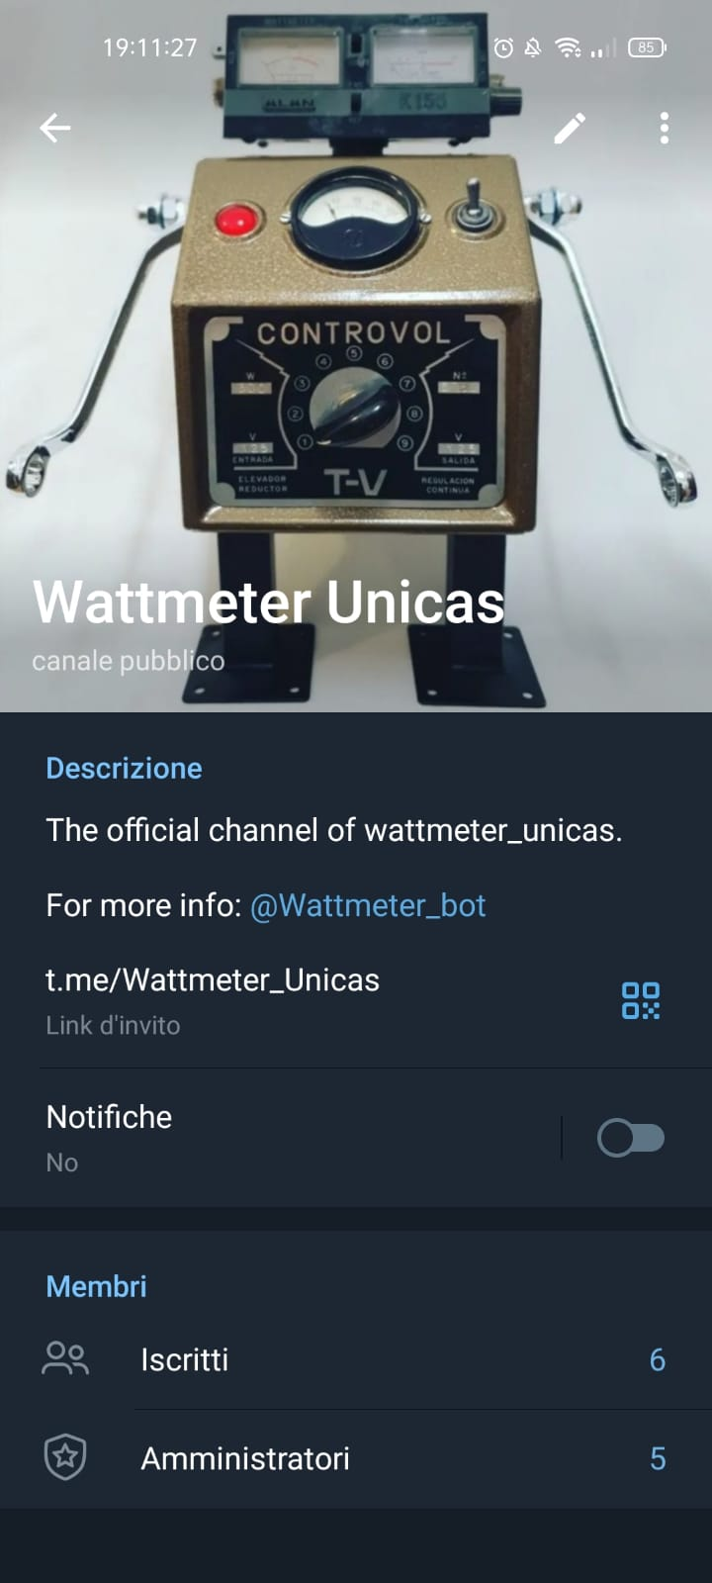
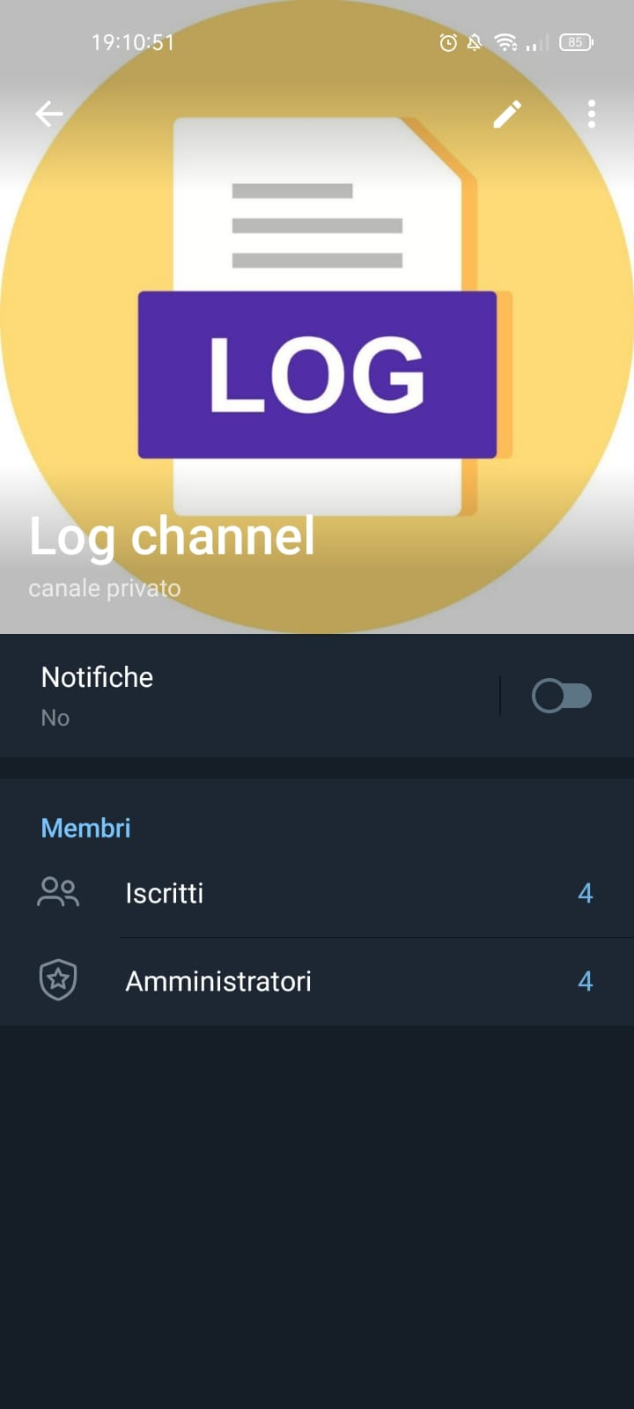
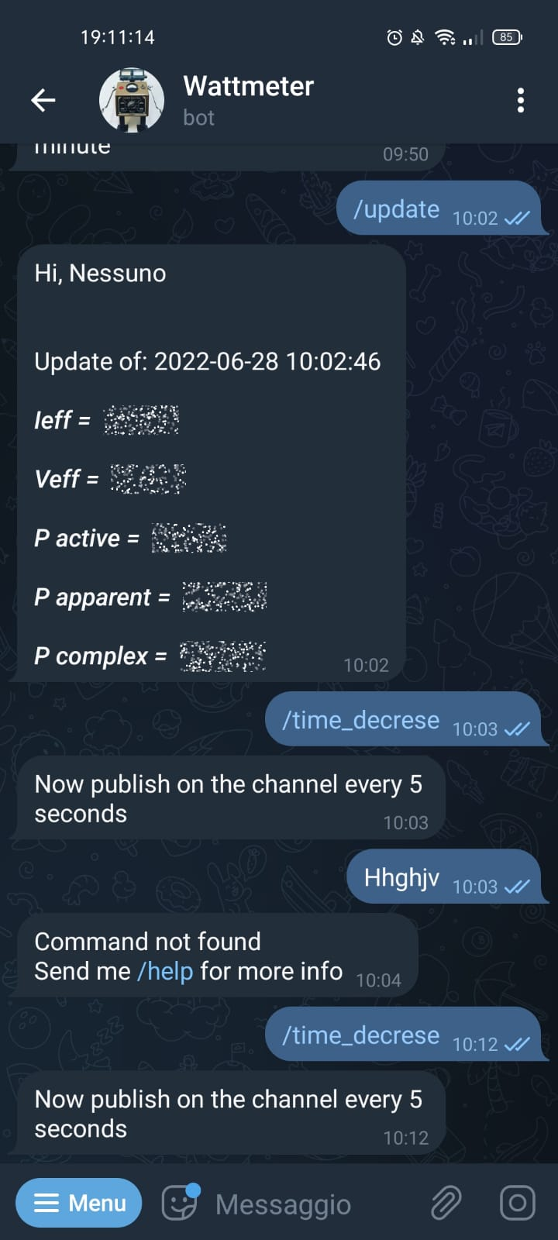
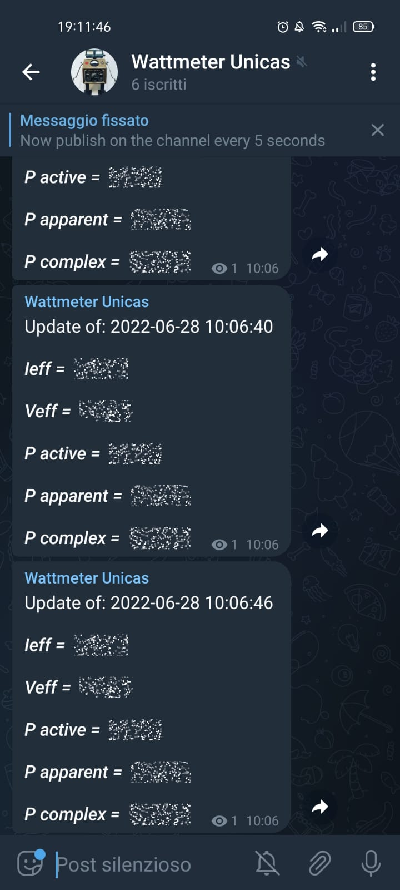
Example:
Esp32-Smart-Plug
Di Gaetano Eugenio

Slide 10

THANKS!
eugeniodg38@gmail.com
telegram username: @Eugeni00
Di Gaetano Eugenio

